Slide 1


Loan Data Analysis

Slide 2
Description of the data
We have been provided with the data which contains value of a loan details. Our objective is to do data analysis and further make a model using labels which will predict values whether the loan is good for the borrower or bad. The data does not contain any missing values; however, the labels are not in proper format, so we must do some manual cleaning of the data.
Further we have performed basic analysis of the data and did some visualization and brought import aspects to take care. We further did some feature engineering and removed few labels which doesn’t have a significant impact on our target variable.
Nor we move to our mathematical modelling and here we used models like Logistic Regression, Gaussian Naïve Bayes and Random Forest Classifier. Apart from this we have also implemented deep neural network to see if it can give us better performance than our previous models.

Slide 3
USE CASE
Following dataset can be used by a service provider company or a bank to provide loan related services to their customers.
The service provider can tell its client whether the loan is good for him based on his financial information like income, loan period, loan amount, loan interest, home ownership etc.
The service can compare the loans of various of banks and come up with most suitable loan for its client based on the information given by the client.

Slide 4
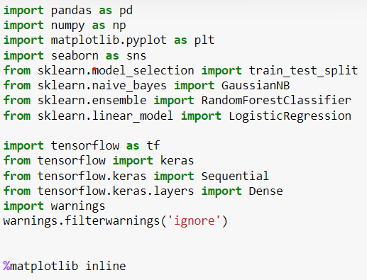
LIBRARIES USED
Two libraries for data visualization – Matplotlib and Seaborn has been used
Multiple sub libraries of sklearn are used for preprocessing and model making
A deep learning framework – Tensorflow is also used to implement deep neural network

Slide 5

SPLITTING OF DATASET
Data leakage (or leakage) happens when your training data contains information about the target, but similar data will not be available when the model is used for prediction. This leads to high performance on the training set (and possibly even the validation data), but the model will perform poorly in production.
In other words, leakage causes a model to look accurate until you start making decisions with the model, and then the model becomes very inaccurate.
To avoid data leakage we generally split the data at the beginning of the data reading and separately perform data cleaning and feature engineering on the test set and the training set.
What is data leakage?

Slide 6
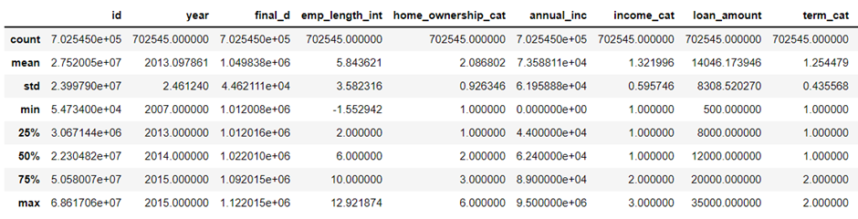
BASICS STATISTICS OF THE DATA

Slide 7
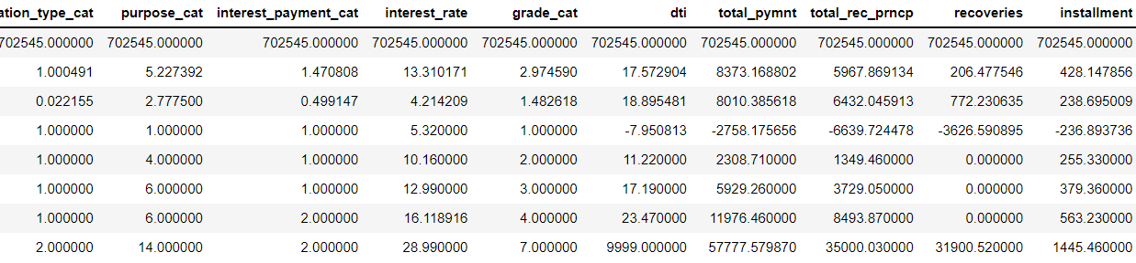
BASIC STATISTICS OF OUR DATA

Slide 8
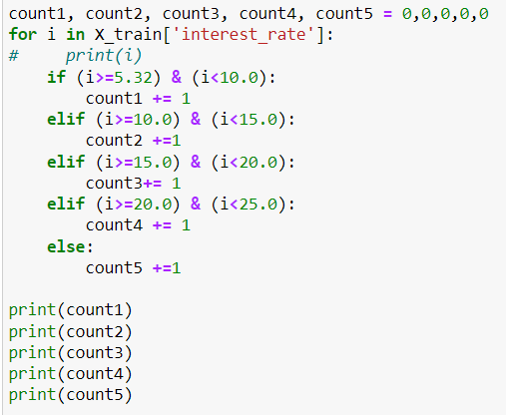
BASIC EDA
168007 rows have interest rate in the range of 5.32 to 10.0
313558 rows have interest rate in the range of 10.0 to 15.0
178556 rows have interest rate in the range of 15.0 to 20.0
38111 rows have interest rate in the range of 20.0 to 25.0
4313 rows have interest rate higher than 25.0

Slide 9
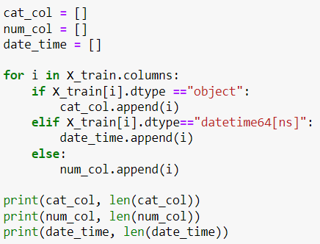
CLASSIFICATION OF CATEGORICAL AND NUMERICAL COLUMNS
8 columns are categorical columns
19 columns are numerical columns
2 columns have datetime format

Slide 10
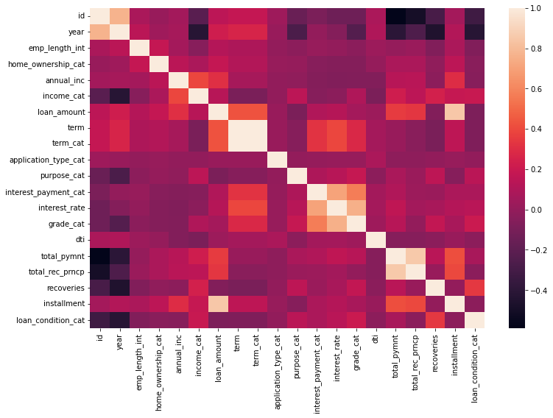
VISUALIZATION OF DATA
CORRELATION OF LABELS WITH TARGET

Slide 11
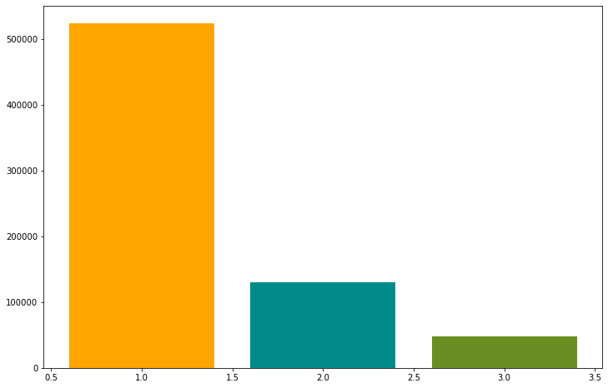
RELATION BETWEEEN INCOME CATEGORY VS LOAN APPLICANTS
We observe that most of the loan have been applied by the person whose income lies in the category of 1 i.e. having income in the range of approx. 0 to 60000 USD
Thus the service provider can invest and target more people with income that lies within that range.

Slide 12
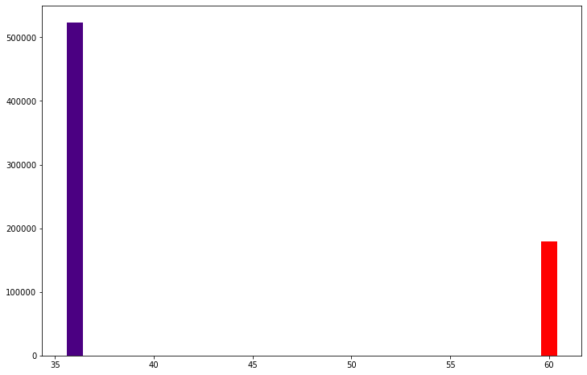
RELATION BETWEEN LOAN DURATION VS NUMBER OF LOANS
People have preferred short duration of loans i.e. 36 months instead of long duration that is 60 months which is also pretty evident by the amount they will pay as interest will increase during long period of loan.

Slide 13
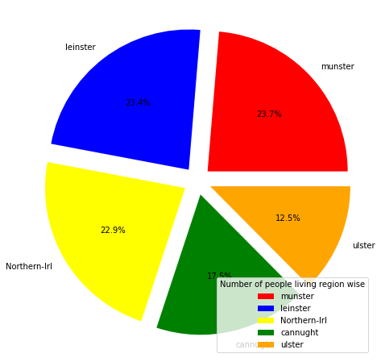
PEOPLE LIVING IN VARIOUS AREAS
We can infer that people from “Munster”, “Leinster” and “Norther-Irl” have applied most for the loan.

Slide 14
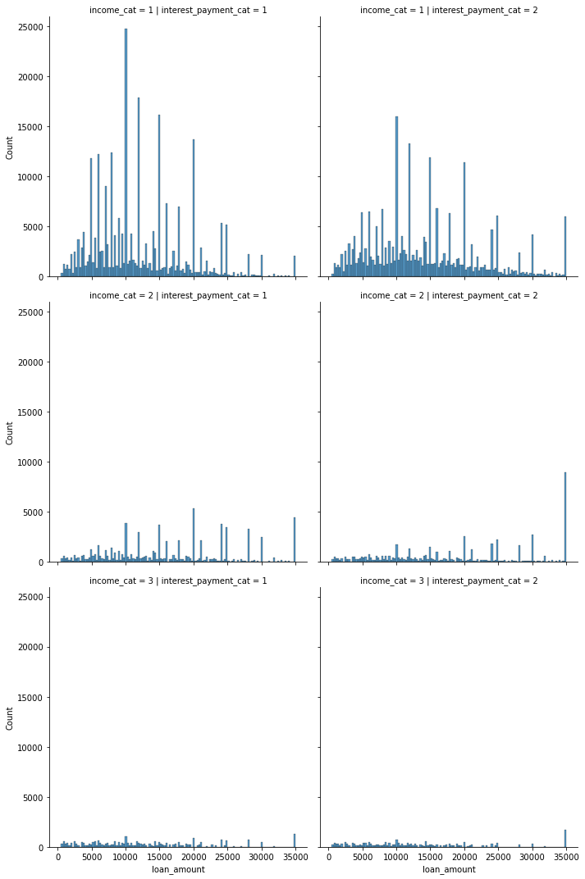
RELATION B/2 INCOME_CAT, LOAN AMT & INTEREST CATEGORY
A huge number of people having income category as 1 have applied for loan.
People from income category 2 have agreed to pay a higher amount of interest than any other income category person.
Most of the people have applied loan in the range of 10,000 USD to 20,000 USD. In this range people have mostly applied for 10,000 USD

Slide 15
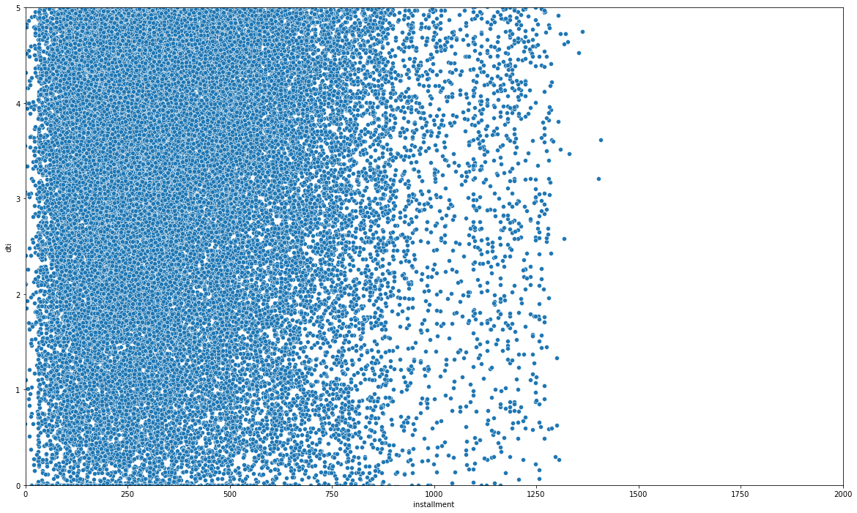
RELATION B/W DTI AND INSTALMENT
From this graph we can conclude that people have opted for loans which provide them with instalment less than 900 USD

Slide 16
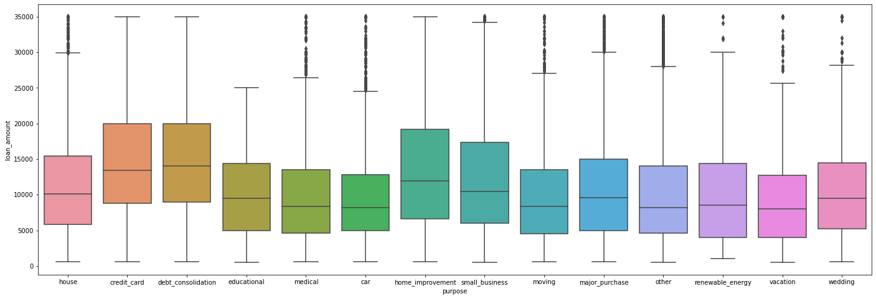
PURPOSE OF LOAN

Slide 17
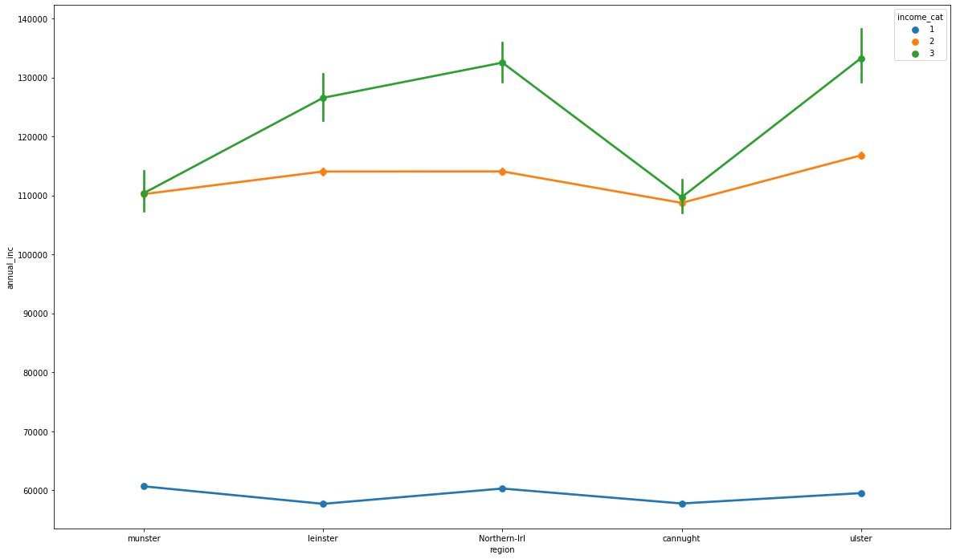
REGION VS INCOME
People from munster and Northern-irl has a greater number of people in category 1 of annual income i.e., more people from this region has applied for the loan
Also, the people from Ulster have a greater number of people from income category 2 and 3. Hence there is lesser chance of people applying for loans.

Slide 18
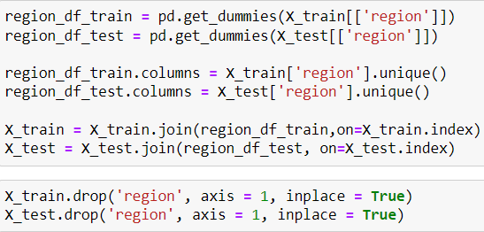
ONE HOT ENCODING
Here we will use pandas inbuilt function pd.get dummies to convert categorical columns into numerical category columns

Slide 19
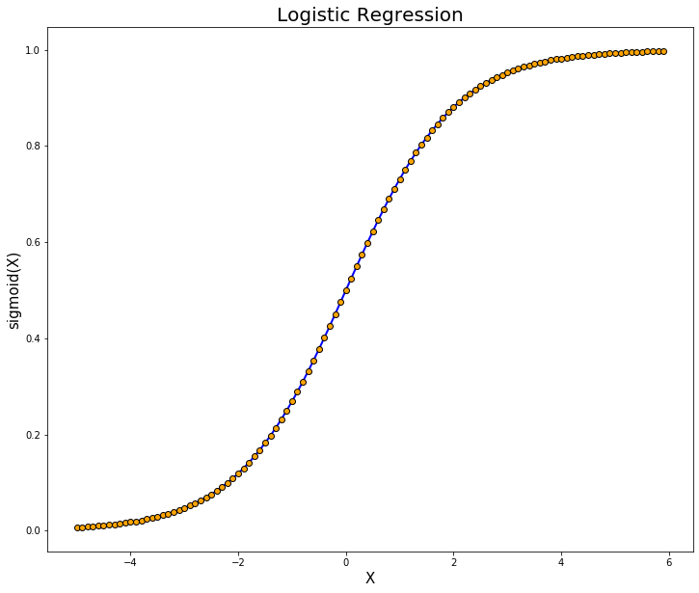
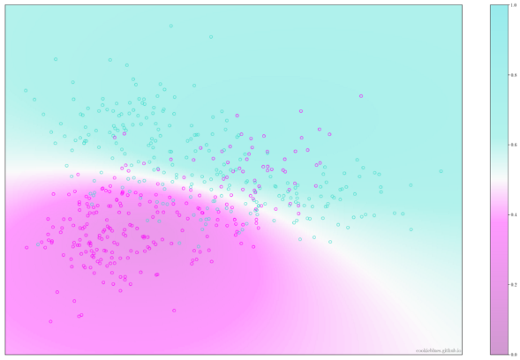
MODELS USED
LOGISTIC REGRESSION
GAUSSIAN NAÏVE BAYES

Slide 20

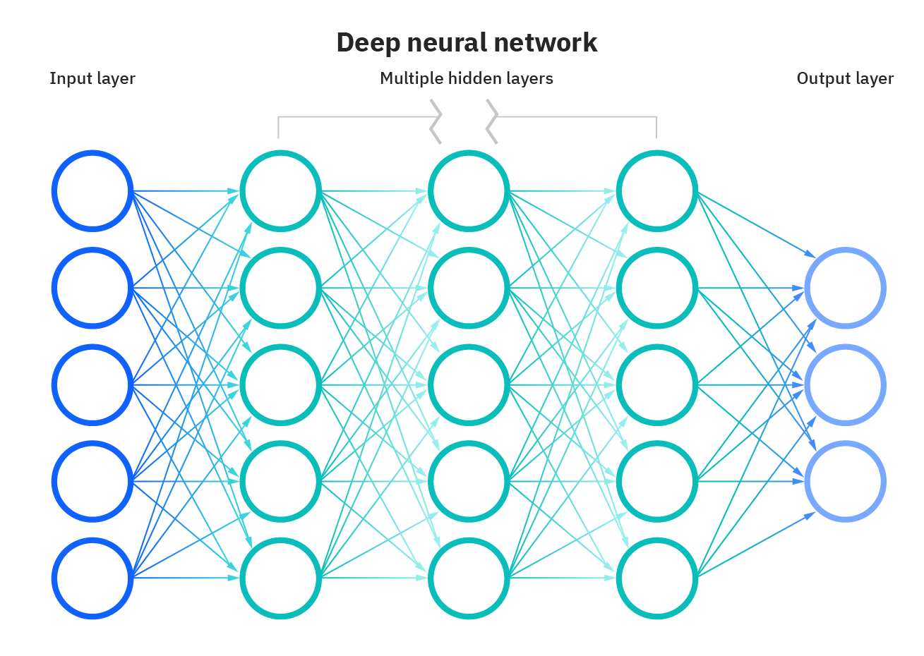
MODELS USED
RANDOM FOREST CLASSIFIER
DEEP LEARNING NETWORK

Slide 21
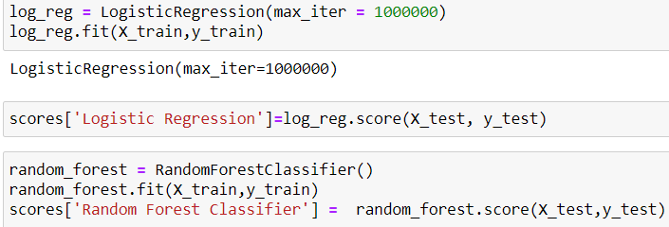

EVALUATION OF MODELS
LOGISTIC REGRESSION
GAUSSIAN NAÏVE BAYES

Slide 22

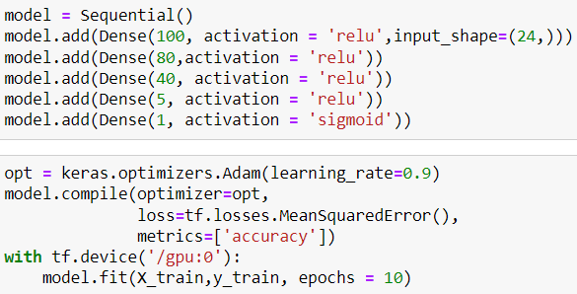

EVALUATION OF MODELS
RANDOM FOREST CLASSIFIER
DEEP LEARNING NETWORK

Slide 23
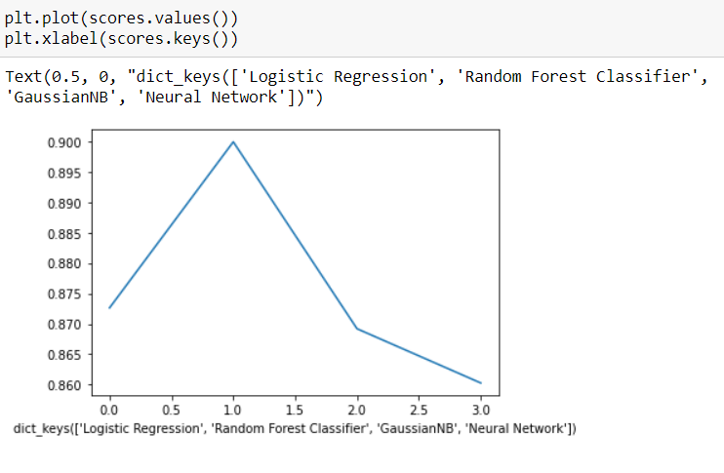
PLOTTING ACCURACIES OF MODELS

Slide 24
HENCE WE CONCLUDED THAT RANDOM FOREST CLASSIFIER HAS HIGHEST ACCURACY AMONG ALL OTHER MODELS OF APPROXIMATELY 90%

Slide 25
Aditya Kulshrestha
Kulshresthaaditya02@gmail.com
8787252884

